Slide 1
School’s Infrastructure Analysis
Prepared by
Linxsly ALEXIS

Slide 2
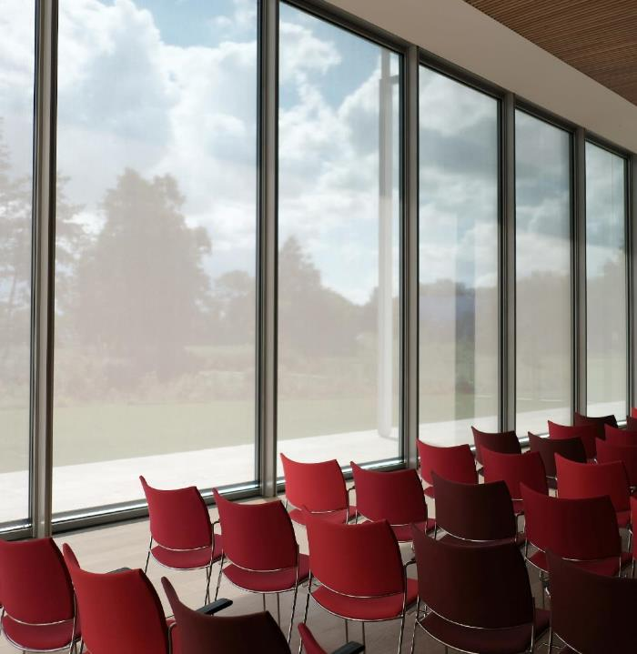
Table of contents
Introduction
Exploratory & Analysis
Recommendations
Problems to solve
Visualization
Propose Solution
Goal of the project
Machine Learning
Presentation
Public cible
Thank you
Data Source
Methodology

Slide 3

Story Telling
You live with a family? You have children? Brothers? Sisters?
You have to move on with your family from a department to another one? What about your children’s career? Which school would you choose for them?
So many unanswered questions... Perhaps due to a lack of information about the infrastructure of the schools or a lack of knowledge about their performance.
3

Slide 4

Problems to be solved
We would like to rank the schools according to their vulnerability in relation to their infrastructure and their level of performance.
4

Slide 5
Process
1- Create a score
2- Do a clustering
3- Create a dashboard

Slide 6

Target Audience
1- Families who migrate from a department to another one.
2- The government(MENFP)

Slide 7



Data Source
The data we used comes from the MENFP database, via Ayiti Analytics. And they include the number of schools per municipality, infrastructure, student results, school information.
7

Slide 8



Methodology
Cleaning data
it’s the most hard part , we remove and replace null values and the wrong values.
Collect data
We receive data from DHS P rogram
We complete the dataset with the data from Ayiti Analytics data
We use Open Street Map API to ﬁnd geolocate
Analysis
We analyze the data
We perform a Machine Learning (K_means Clustering)

Slide 9
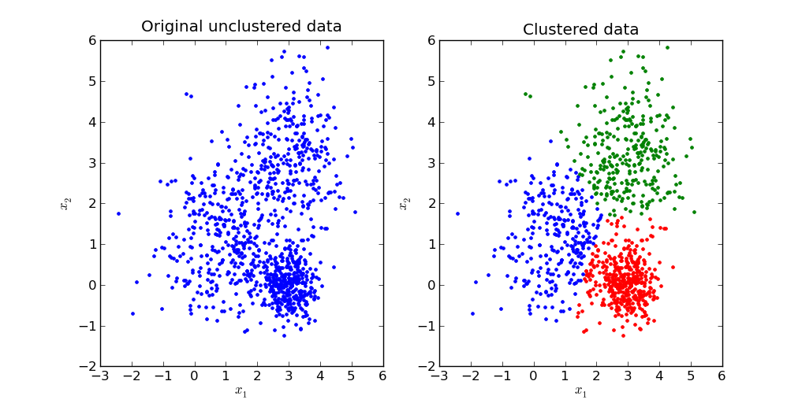
KMeans Clustering
We will perform a k-mean clustering which consists in grouping the data in several groups of commune in our case according to the similarities of their schools’ infrastructure or results after having determined the optimal number of group or cluster = k. In our case k=3.

Slide 10
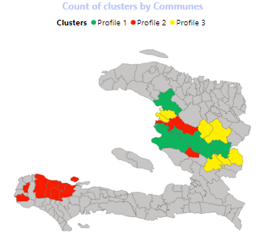
This map shows the distribution of the clusters by commune for the three departments that I had to work on.
(Centre, Artibonite, Grande’Anse)

Slide 11
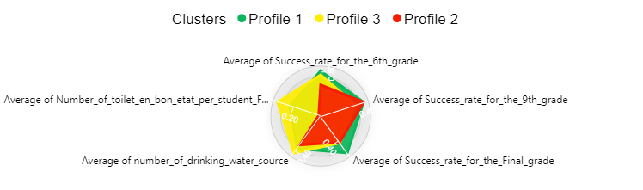
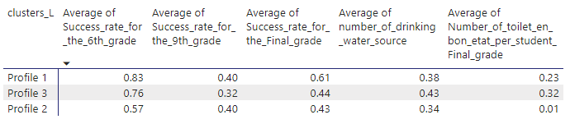
Description of the clusters
This is a description of the three clusters, we can notice that there’s a small difference of the success rate in the three clusters, and for the infrastructure too…
We can notice the profile the most vulnerable is the second one. They have less infrastructures than any others.

Slide 12
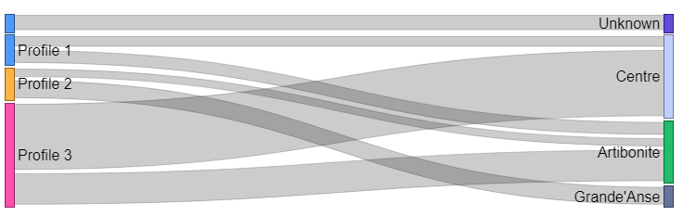
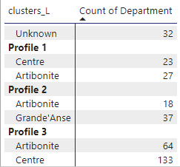
This graph shows the number of clusters by department. The second profile, which is the worst, is the only one profile to have school in Grande’Anse. That means, in this department, there are not only an infrastructure’s problem but also an educational problem.

Slide 13
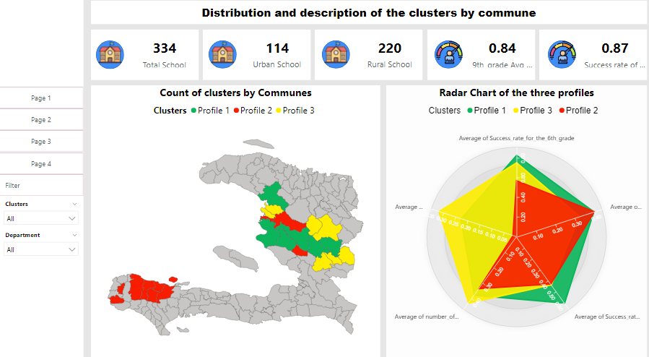

Slide 14

Recommendations
We will suggest the government to give more grant programs in the municipalities which are pofile 2.

Slide 15
Recommendations
According to the data and analysis, we will suggest the family to use our dashboard, more precisely the radar chart to see clearly the municipalities with the best performance and the best infrastructures. If they need to introduce some others factors

Slide 16




Contact
Linxsly ALEXIS
+509 46976429
alexislinxsly@gmail.com

Slide 17
Thank You
For The Attention

Slide 18
QUESTIONS?

